Slide 1

Entrepreneurship
Dr. Zunaira Saqib

Slide 2

Week 1
Introduction to Entrepreneurship

Slide 3

Introductions
Name
Why are you in this course?

Slide 4

What Do You Want to Learn?

Slide 5
Course Outline
Contents
Assignment
Project
Quizzes
Groups
Attendance
Readings Uploading

Slide 6

Small business vs. Entrepreneurship (Startup)

Slide 7

Small Business
A company (Usually, a sole-proprietorship or partnership) operating locally, and does not have access to a vast amount of resources or capital.
Safe Business – Low Risk

Slide 8

Entrepreneurship or Start ups
An individual acting on an idea, usually to disrupt the current market with a new product or service.
Entrepreneurship usually starts as a small business but the long-term vision is much greater, to seek high profits and capture market share with an innovative new idea.
Disruption – High Risk

Slide 9

5 Key Differences
Innovation
Risk
Funding
Growth
Profit

Slide 10

10 Startups that Disrupted

Slide 11
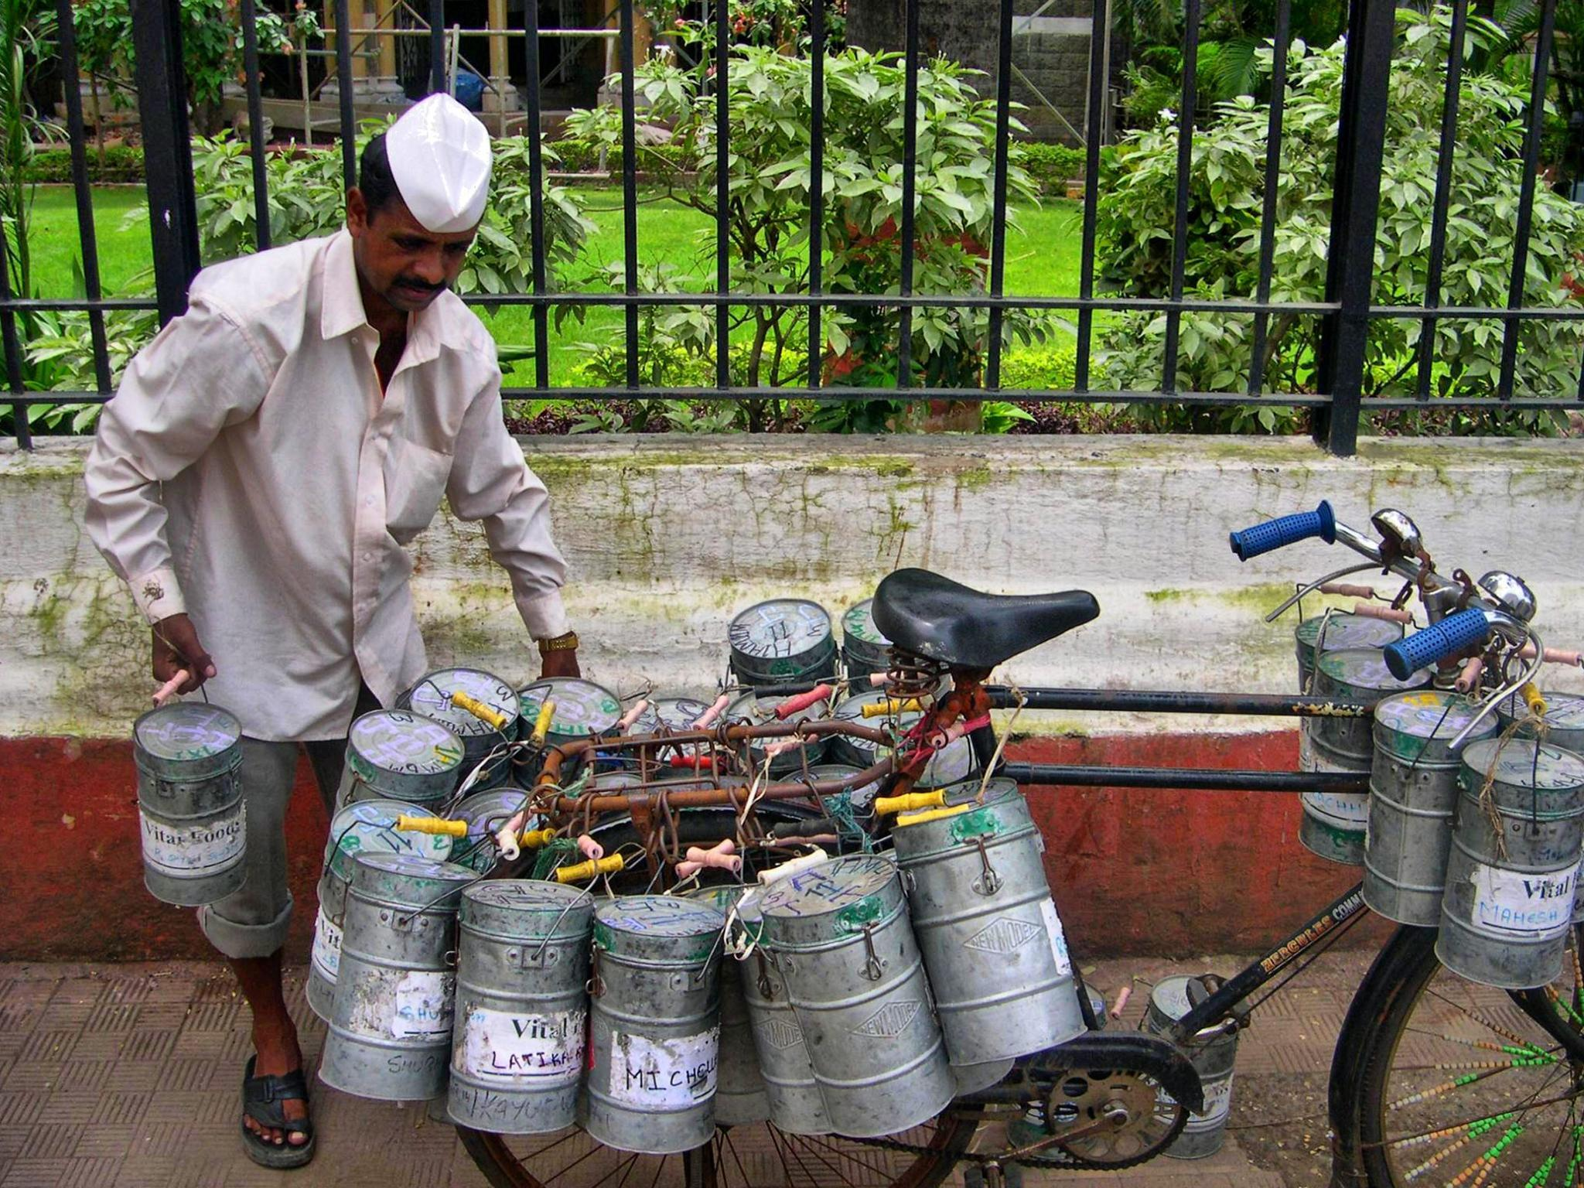
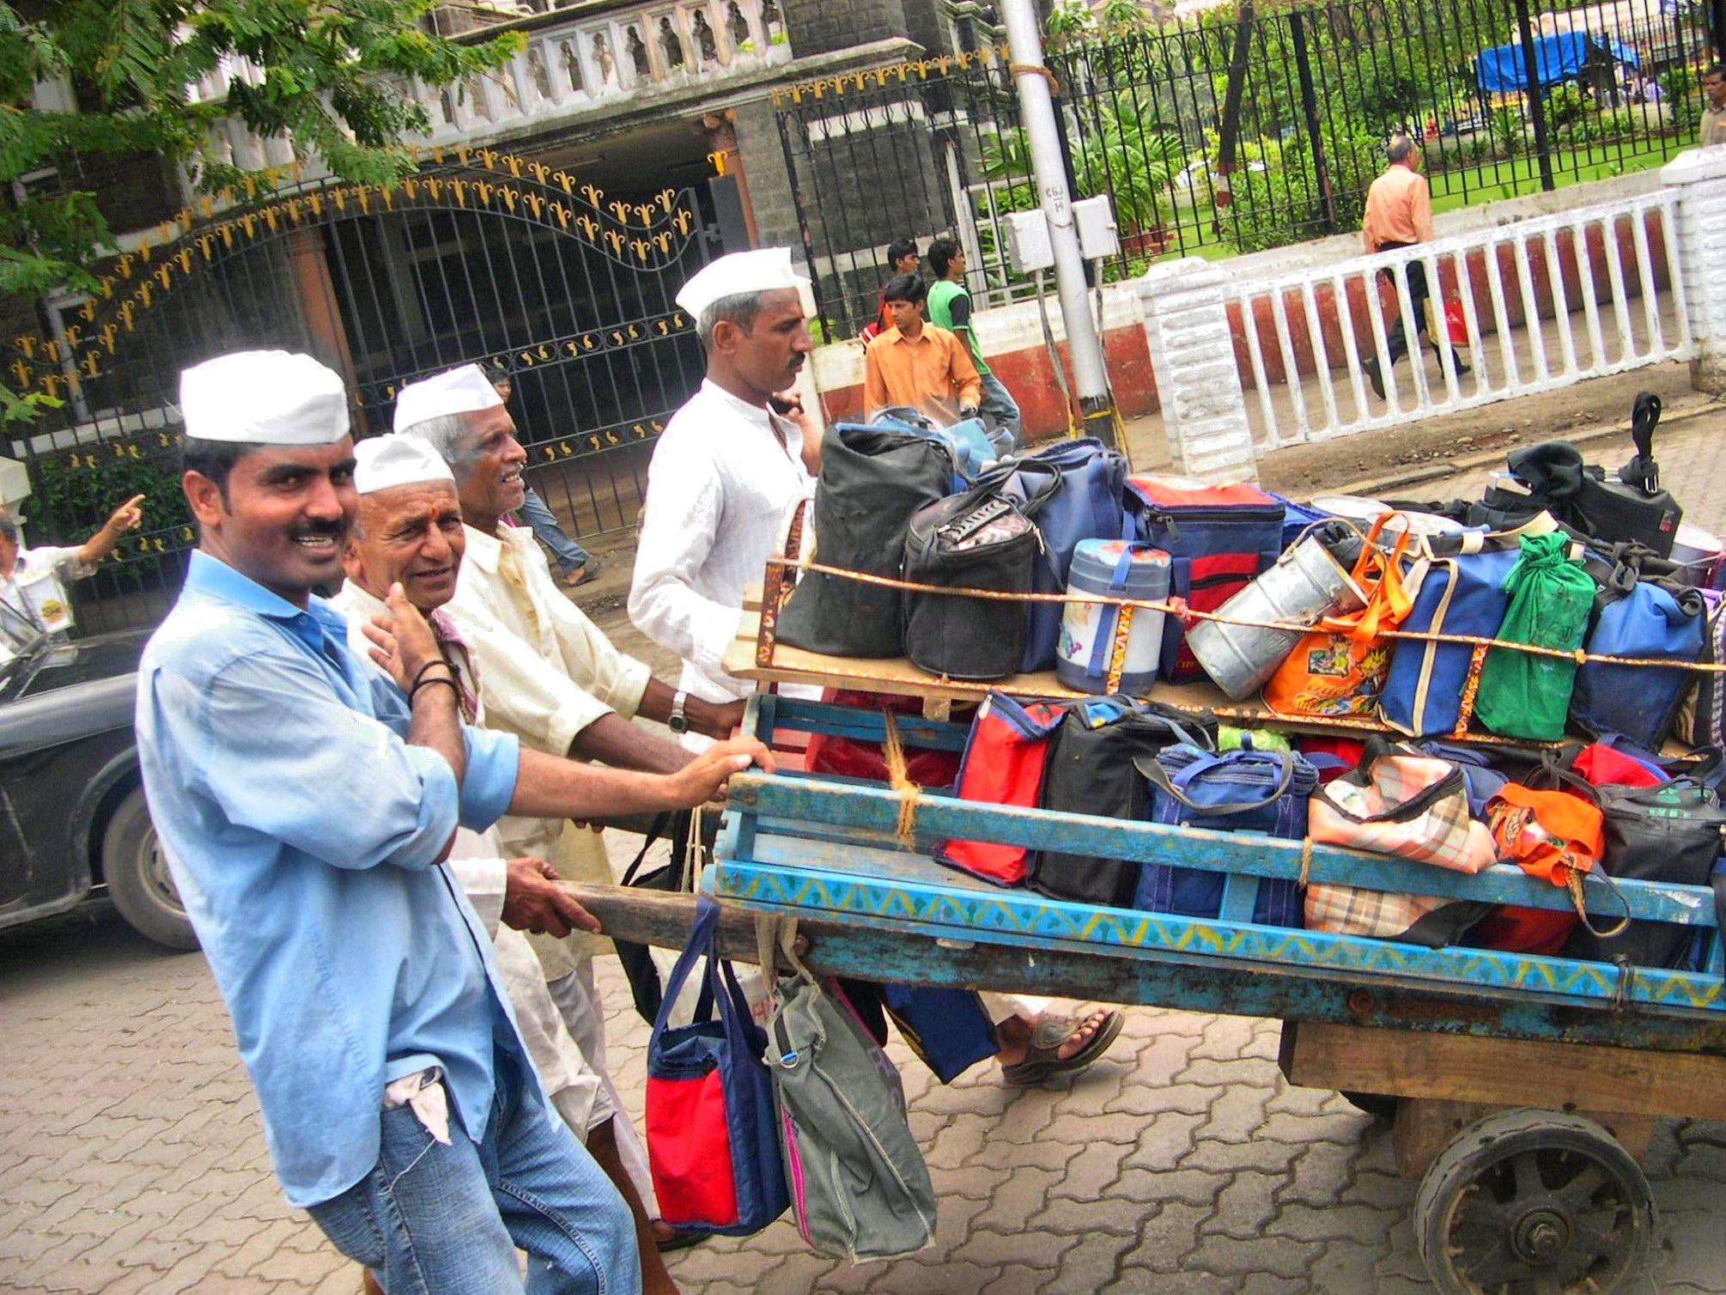
Mumbai’s Dabbawallas and FlipKart

Slide 12

Pakistani Startups and What Did they Disrupt?
EasyPaisa
Airlift
Bykea
Food Panda
Dawaai
Blinkco
Sadapay

Slide 13

What Should be the Purpose of a Startup?
Value Addition?
Scalability?
Making a difference?
Profit / Money?
TEST YOUR PURPOSE

Slide 14
Week 2
The Entrepreneurial Mindset
Self Awareness
Do You Have What it Takes?

